Slide 1



1
Sport Events App
Mohammad Dukhi
&
Ahmad Abo Jabal
25-2-D-28
Supervisor: Dr. Zeev Frenkel

Slide 2

2
Introduction and Problem Statement
The current landscape of sports event engagement is fragmented, leading to significant inefficiencies and missed opportunities for fans, venues, and event organisers. We aim to address these pain points.
Fragmented Information
Inefficient Engagement
Underutilised Data
Fans struggle to find comprehensive event information, ticket availability, and real-time updates across multiple platforms.
Limited interactive features hinder fan engagement pre- During- and post-event, reducing overall satisfaction.
Venues and organisers lack a unified view of fan behaviour, limiting their ability to personalise experiences and optimise operations.

Slide 3




3
Our Solution – A Unified Smart Sports App
We propose a comprehensive solution: a smart sports app that seamlessly integrates all aspects of sports event engagement.
Unified Ticketing
Real-time Updates
Centralised platform for discovering, purchasing, and managing tickets for various sports events.
Instant notifications for match results, schedule changes, and personalised offers.
Enhanced Fan Engagement
Actionable Insights
Interactive features like polls, forums, and social sharing to connect fans.
Data analytics for venues and organisers to understand audience behaviour and preferences.

Slide 4






4
Key Features of Our App
Live Updates
Instant scores, real-time actions, notifications.
Smart Ticketing
Browse interactive maps, real-time availability, secure booking.
Personalized experience
Chosen personalization will give a tailored content for each user.
AI Recommendations
Insure never missing the opportunity to have best recommendations.
Team Insights
Team profile with stats, historical data, latest contracts, and more.

Slide 5




5
What Makes Us Unique?
Unified Ecosystem
Intelligent Personalisation
Integrating live data, ticketing, and AI-driven recommendations into one seamless platform.
AI delivers smart contents with seat selection, match prediction, and unique experiences for every user.
Actionable Insights
Authenticated ticket booking
Providing real-time data and analytics for everyone.
Supporting users from all over the world with a good tier tickets and best prices comparing with other competitors.

Slide 6
6
Who Benefits from Our System?
Our solution provides immense value to all key stakeholders within the sports ecosystem.
Sports Fans
Easy access to events, personalised experiences, and enhanced community interaction.
Event Organisers
Streamlined event management, improved audience reach, and valuable data insights.

Slide 7



7
AI-Powered Seat Suggestion
Seat Suggestion AI
Our AI-driven recommendation engine suggests optimal seating based on user preferences, viewing angles, and historical data.
User Preferences
Price range, section, accessibility needs.
Venue Data
Seat availability, viewing angles, historical popularity.
Real-time Optimisation
Dynamic pricing, demand-based adjustments.

Slide 8
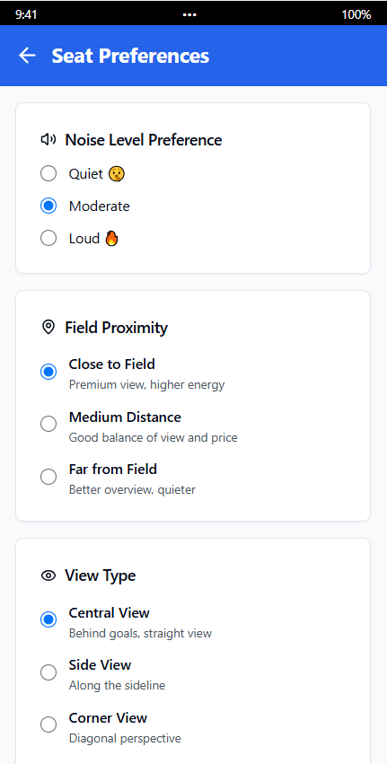
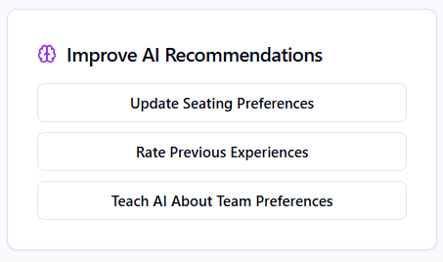
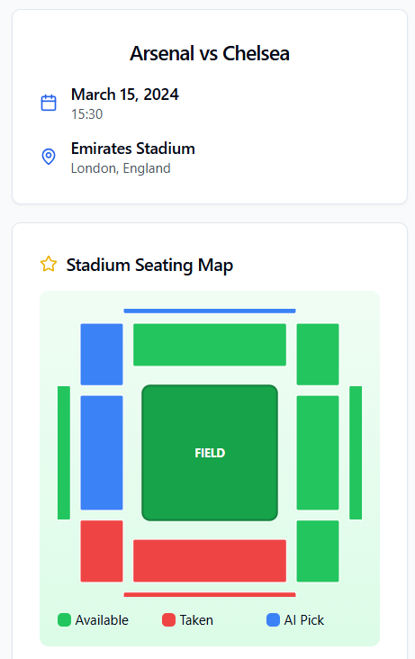
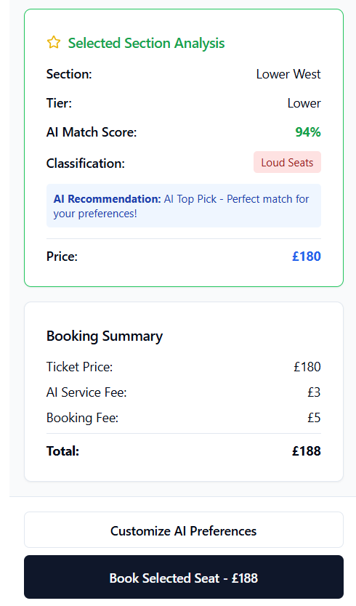
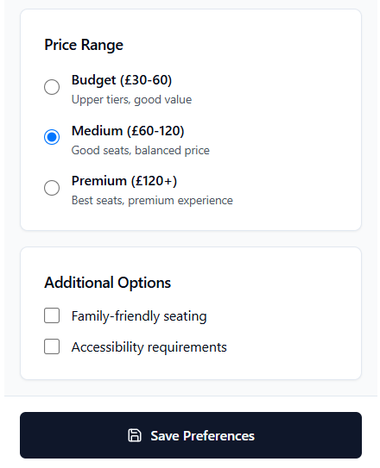
8
Buying Tickets

Slide 9
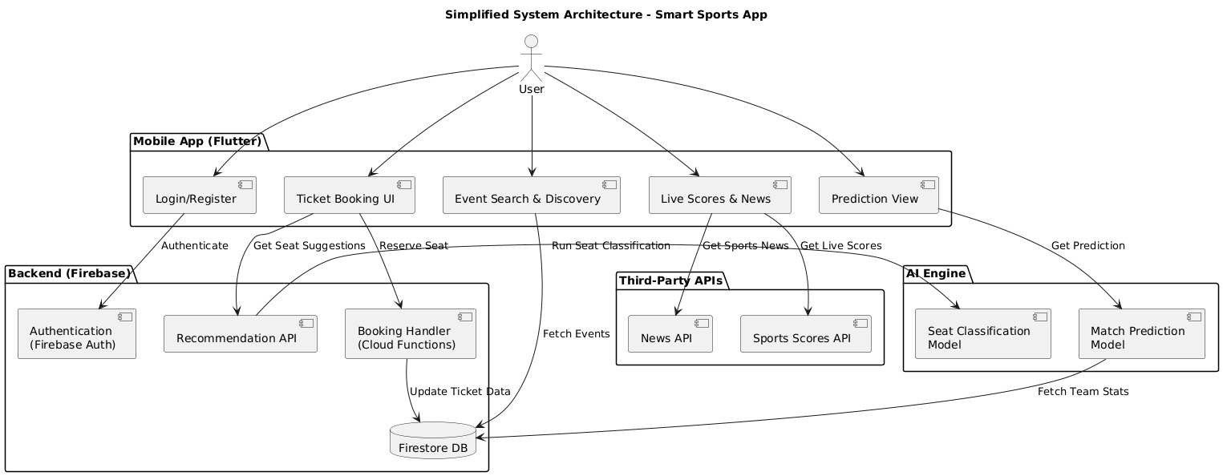
9
System Architecture Overview

Slide 10
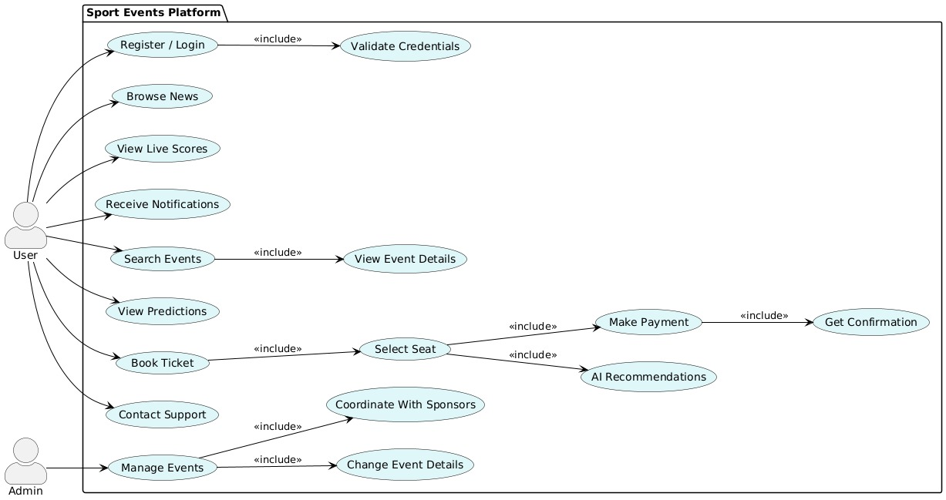
10
Use-Case Diagram

Slide 11
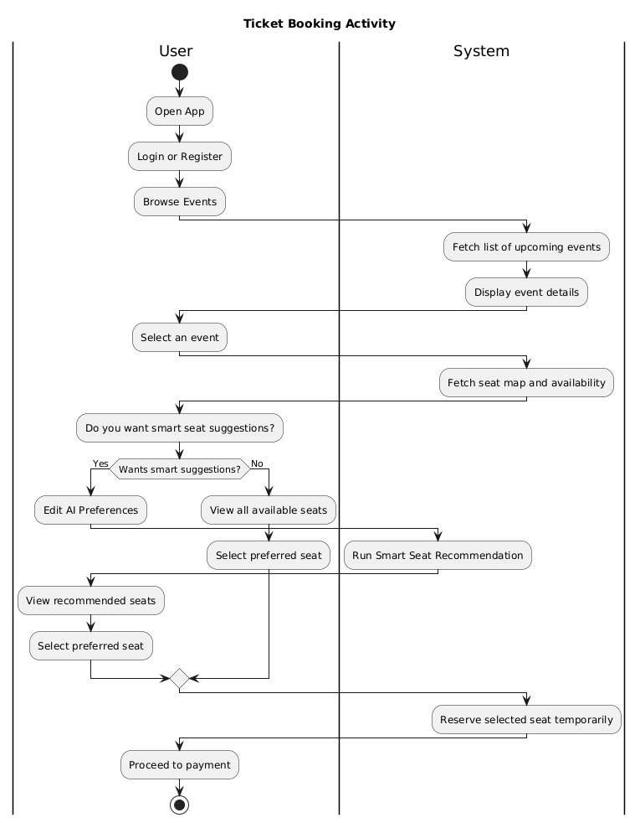
11
Ticketing part of our Acitvity Diagram

Slide 12
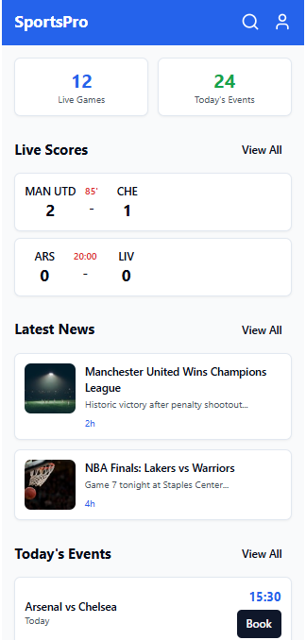
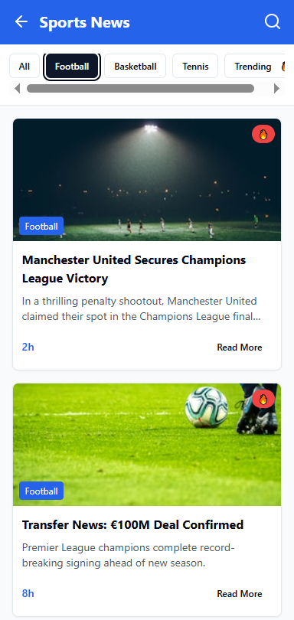
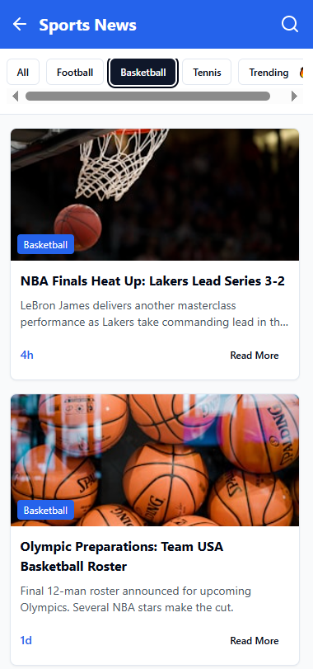
12
Homepage & News

Slide 13
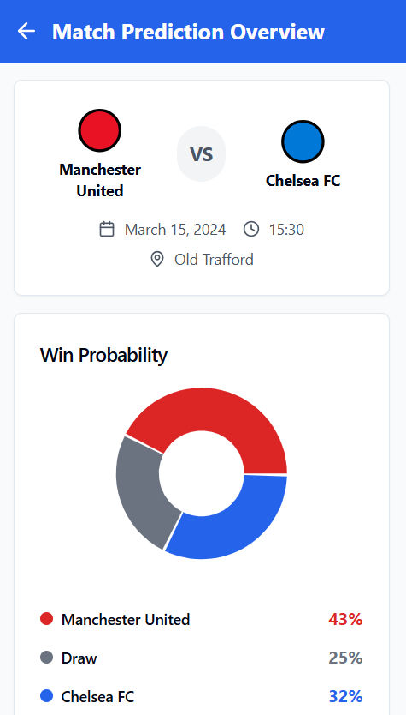
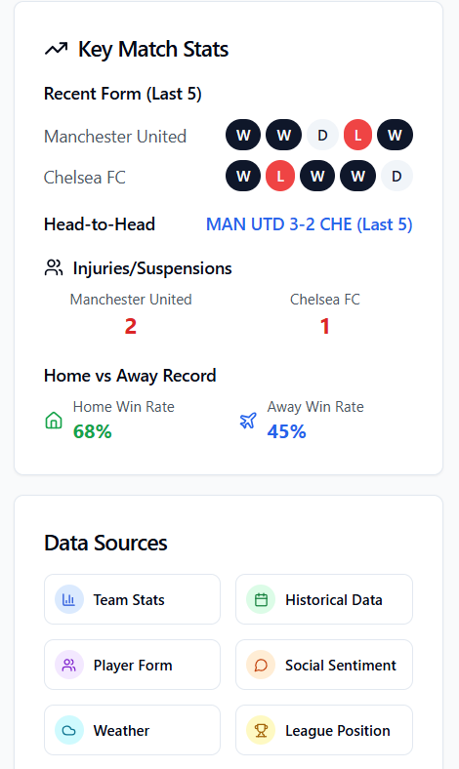
13
Prediction Overview

Slide 14




14
Tools and Technologies
We are planning to use cutting-edge technologies to build a robust and scalable platform.

Slide 15
15
Quality Assurance
Ensuring Stability (Testing Strategy)
Measuring Our Success (Success Criteria)
Unit Testing: to validate core functionalities.
Users receive accurate and relevant recommendations.
performance Testing: ensure stability during high loads, like match days.
The booking flow works without errors.
User Acceptance Testing (UAT): Ensuring the app meets user needs and expectations.
Admins are able to manage events smoothly.

Slide 16





16
Our Development Approach
Requirement Gathering
In-depth surveys, reviews, and market research to define app features and user needs effectively.
System Design
Crafting a robust architecture for frontend, backend, and database to ensure scalability and performance.
Feature Implementations
Building core functionalities including user authentication, secure ticket booking, and AI recommendations.
Testing
Comprehensive unit, integration, and user acceptance testing to guarantee a stable and bug-free experience.
Deployment & Launch
Ensuring optimal performance, scalability, and reliability across all user devices from day one.

Slide 17



17
Engineering Difficulties
Developing a complex platform like this comes with some technical challenges.
30%
50%
20%
Scalability
Real-time Data Processing
Security & Data Privacy
Ensuring the system can scale efficiently to handle increased user traffic and data without performance issues.
Ensuring instant updates for ticket availability, scores, and event changes.
Implementing a secure login system to prevent unauthorized access and protect user credentials.

Slide 18
18
Future Work
Our app promises to revolutionise the sports event experience for all users.
Future Enhancements
Augmented Reality (AR) venue navigation.
Gamification elements for increased user engagement.
Adding video highlights and post-match analysis.
Adding text updates for live matches.

Slide 19
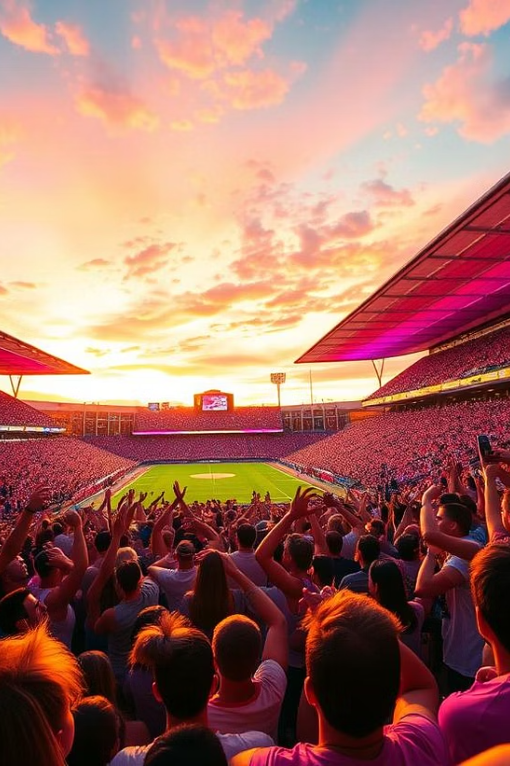
19
Thanks
For
Listening

